Slide 1
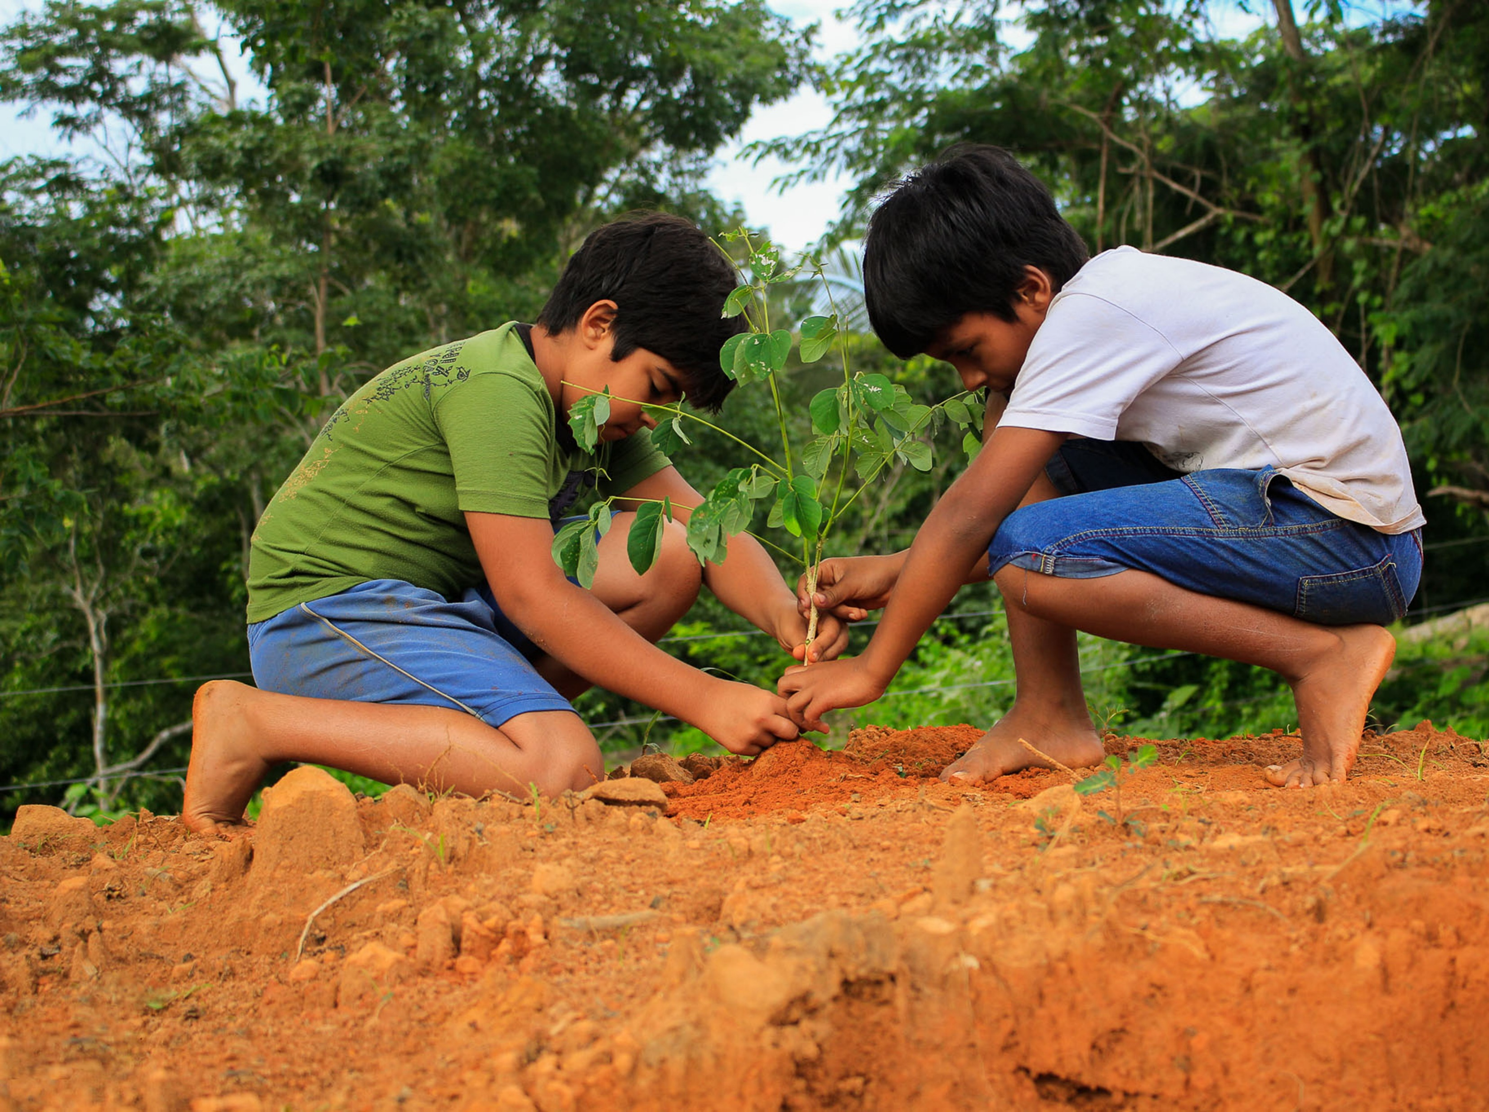
Unpacking New Consumer Outlooks on ESG
A Panel on What Matters to Customers and the Planet
© 2021 Nielsen Consumer LLC. All Rights Reserved.
Notes:
Which categories are seeing the most growth in sustainability attributes and claims?
What social and sustainable attributes matter most to consumers right now?
What’s the impact of inflation on sustainability growth across categories?
Where does consumer interest in regenerative business intersect with equity and diversity?
How are brands leading the way in good for the planet + good for people initiatives?
What are new ways of collaboration, new business models, new ways of educating shoppers?
How are brands are measuring the success of their ESG initiatives?
Which categories are seeing the most growth in sustainability attributes and claims?
What social and sustainable attributes matter most to consumers right now?
What’s the impact of inflation on sustainability growth across categories?
Where does consumer interest in regenerative business intersect with equity and diversity?
How are brands leading the way in good for the planet + good for people initiatives?
What are new ways of collaboration, new business models, new ways of educating shoppers?
How are brands are measuring the success of their ESG initiatives?
Speaker:
Sherry Frey, Vice President Total Wellness, NielsenIQ
Julia Collins, Founder and CEO, Moonshot Snacks and Planet FWD
Matthew Moore, Sr. Director of Category Management, Banza
Steven Jamieson, HBC Merchandiser, PCC Community Markets
Spike Mendelsohn, Founder and Chef, Eat the Change/Just Ice Tea/PLNT Burger

Slide 2
Changes will shape and guide
consumer choice
78%
say a sustainable lifestyle is important to them
61%
agree environmental issues are having an adverse impact on their current and future health.
30%
are more likely to buy products with sustainable credentials
Source: NielsenIQ Global Health & Wellness Study of 17 markets, September 2021, US results; NielsenIQ Omnibus Survey, Dec 2021
2
Notes:
Consumers recognize their world is changing and health needs are increasing important…whether it’s the increased importance of universal healthcare, or the added concerns that environmental issues are affecting our health. There have been some positive impacts of the pandemic…as more consumers found it easier to be healthy when they’re spending time at home.
Working from home made it easier to eat healthfully and showed us the impact on the planet (when we stopped commuting, the earth started to repair itself).

Slide 3
Consumers’ health and wellness needs have evolved beyond the basics of physical wellbeing
NielsenIQ hierarchy of total health & wellness needs
Urgent care
Protecting myself and/or my family members from immediate health threats.
Protective
Self care
Improving my and/or my family's current physical or emotional wellbeing and connections.
Preservation
Preventative care
Proactive actions to achieve & maintain specific health goals or helping to avoid ailments in the long-term.
Aspirational
Innovative care
Seeking out the latest alternatives or developments to continuously meet my and/or my family's health & wellness goals.
Evolving
Selfless care
Improving the world around me by advocating for environmental, ethical, humanitarian, and/or philanthropic causes.
Altruistic
Notes:
Protective
Cleaning and Antibacterial
Innovative
Ingredients/Form
Clean Label
Altruistic
Sustainable
Socially Responsible
This hierarchy, applied to the current state of health and wellness, brings to light a total view of consumer health needs. It highlights unique differences in the innate order to which consumers are prioritizing their health needs: those that are protective, preservation-focused, aspirational, evolving, and altruistic in nature.
Similar to Maslow’s hierarchy, from a very base level: are my personal and urgent needs being met to thinking about my care, to thinking about my future, to thinking outside of myself – to others and society.
What are the current and future opportunities that exist for your company both up and down this hierarchy?
The hierarchy framework is fluid across consumer segmentations, geographic regions, key demographics, cultures, and categories. In practice, it will align with any personal health and wellness journey. The opportunity for companies looking to meet and exceed the growing expectations of wellness-minded consumers is to figure out where your brand fits and sits along this fluid path. If most consumers prioritize more than one hierarchy level, so should companies.

Slide 4
Climate change tops consumer concerns
Which are you most concerned about?
NielsenIQ Omnibus Survey, Dec 2021, Q1. Which of these topics are you personally most concerned about? Please select all that apply? Q2. Overall speaking, how important is a sustainable lifestyle to you?
Notes:
Q1. Which of these topics are you personally most concerned about? Please select all that apply.
Q2. Sustainability means meeting our current needs without compromising the ability of future generations to meet their own needs.It includes natural resources, economic resources and social resources.Overall speaking, how important is a sustainable lifestyle to you?

Slide 5
Focus on attributes that matter most to consumers now
Hidden Slide
More like to buy: Purchase preference change over the last 2 years (More – less likely to buy)
Health & hygiene |  | Social and sustainable |  | Cost and quality |  | Convenience and time saving |  | Origin and experience
Fresh produce | +26 | Supported consumers during COVID | +22 | Affordable/lower prices | +32 | Makes working at home easier | +14 | Known & trusted | +24
Nutritional benefits | +18 | Environmental/ Sustainable | +17 | Private Label/ Store Brands | +16 | Makes household chores easier | +13 | From my local neighbourhood | +17
Hygiene/safety claims | +17 | Socially responsible | +16 | Guarantees - safety/quality | +11
Healthier options | +17 | Ingredient/supply chain transparency | +14
Source: NielsenIQ 2022 Consumer Outlook Survey, Dec 2021, US
Q. How have your brand and product purchasing preferences changed over the last 2 years (since COVID-19)?
Notes:
These changes in priorities will flow into the decision they make on the products and services they will buy and use and the companies that want to support.
Each of these variables play an important role in how consumers want to shape their lives moving forward
Affordability is critical which comes as no surprise when we consider the circumstances so many consumers have faced over the last 2 years
Fresh produce healthier alternatives and enhanced nutrition enable consumers to be more proactive when it comes to taking charge of their physical wellbeing with a fundamental need for hygiene and safety in all aspects moving forward.
Understanding that the role we play in the world is much bigger than ourselves – seeking out sustainable options; looking out for more vulnerable members of society and ensuring companies are transparent in their supply chains and authentic in what they stand for.
Local origin has become increasingly important – both as a security against availability issues but also to support local economies and protect communities.
Ongoing @ home lifestyles means consumers seek alternatives that make it easier for them to balance work and life priorities.

Slide 6
Across 90+ attributes illustrate care for environment, others and animals all important
+22.1%
Social Responsibility
+24.5%
Environmental
+17.5%
Sustainable Packaging
+37.1%
Animal Welfare
+330.9% Minority Owned +83.8% Women Owned +46.9% B Corporation
+28.9% Fair Trade +27.4% Ethical
+127.5% Regenerative Agriculture +84.1% Renewable Resource +64.9% Reef Safe +44.0% EU Organic Farming +37.3% Less Emissions
+156.9% Plastic Free +99.9% Renewable Pkg Cntnt +35.5% Tetra Pak +34.9% Terracycle
+69.0% Cruelty Free
+43.7% Grass Fed +39.6% Cage Free +39.5% Humane +37.1% Free Range
$ Volume | Total Store Chg. vs 3YA
Claims/Certifications that are stated on package
Source: NielsenIQ Retail Measurement Services, NielsenIQ Product Insight, powered by Label Insight, Total Store; Total US xAOC; Latest 52 weeks W/E 08/06/22 vs 3YA
Notes:
Sustainability means so many things. At NielsenIQ, we track more than 90 attributes around sustainability, in the buckets of social responsibility, sustainable farming, resource management, forestry, packaging and animal welfare.
We see the conversation transitioning from sustainability (which is about minimizing impact) to regeneration (how do we leave the earth better/rebuild the damage that has been done). And beyond just our planet, the conversation is about humanity… how do we care for each other (social responsibility/social equity and justice) and how do we care for all living things (animal welfare).
Growth of these trends is outpacing growth of store. In this green box, we can see products making statements on-package regarding their environmental sustainability practices are up over 13% in sales volume.
We can drill down even further to look at specific certifications around things like Carbon Free, and Reef Safe and these product sales are up over 50%! Pretty incredible numbers. Consumers often say different things than what they actually do, so, I think this slide certainly shows that consumers are indeed demonstrating they care about sustainability.

Slide 7
Growth of ESG claims varies across the store
$ % Chg. vs 3YA – Total Store
Department | Social responsibility | Environmental sustainability | Sustainable packaging | Animal welfare
Total Store | +22.1% | +24.5% | +17.5% | +37.1%
Total Food & Beverage | +37.2% | +28.7% | +20.1% | +34.1%
BevAl | +35.5% | +6.2% | +21.1% | +14.7%
Vitamins/OTC | +98.4% | +28.5% | +12.9% | +27.2%
Beauty/Personal Care | +26.6% | +28.3% | +18.4% | +50.5%
Household Care | -19.1% | +16.2% | +10.4% | +27.2%
Pet Care | -16.0% | +6.9% | +73.7% | +13.0%
Source: NielsenIQ Retail Measurement Services, NielsenIQ Product Insight,, powered by Label Insight, Total Store; Total US xAOC; Latest 52 weeks W/E 08/06/22 vs 3YA
Notes:
Grab super categories for reference
Note: In our NielsenIQ Product Insight, launched this year with our acquisition of Label Insight, we track more than 80+ attributes (up to 93 in some categories) around sustainability, in the buckets of social responsibility, sustainable farming, sustainable resource management, sustainable forestry, sustainable packaging and animal welfare.
At NielsenIQ, we see the conversation transitioning from sustainability (which is about minimizing impact) to regeneration (how do we leave the earth better/rebuild the damage that has been done). And beyond just our planet, the conversation is about humanity…how do we care for each other (social responsibility/social equity and justice) and how do we care for all living things (animal welfare). Growth of these trends outpacing growth of store. (Note: only the bottom line is 2YA, all other trends on slide are YA.)
Callouts:
Social decline in HH Care driven by:
Paper & Plastics (-22% and makes up 90% of SCL RSP volume)
Home Air Freshener (-32% and makes up 0.3% of vol)
Social decline in Pet Care driven by:
Pet Food (-17.9% and makes up 97% of vol)
Dog Food (-9.6%) = 95% of the vol
Cat Food (-81.7%)

Slide 8
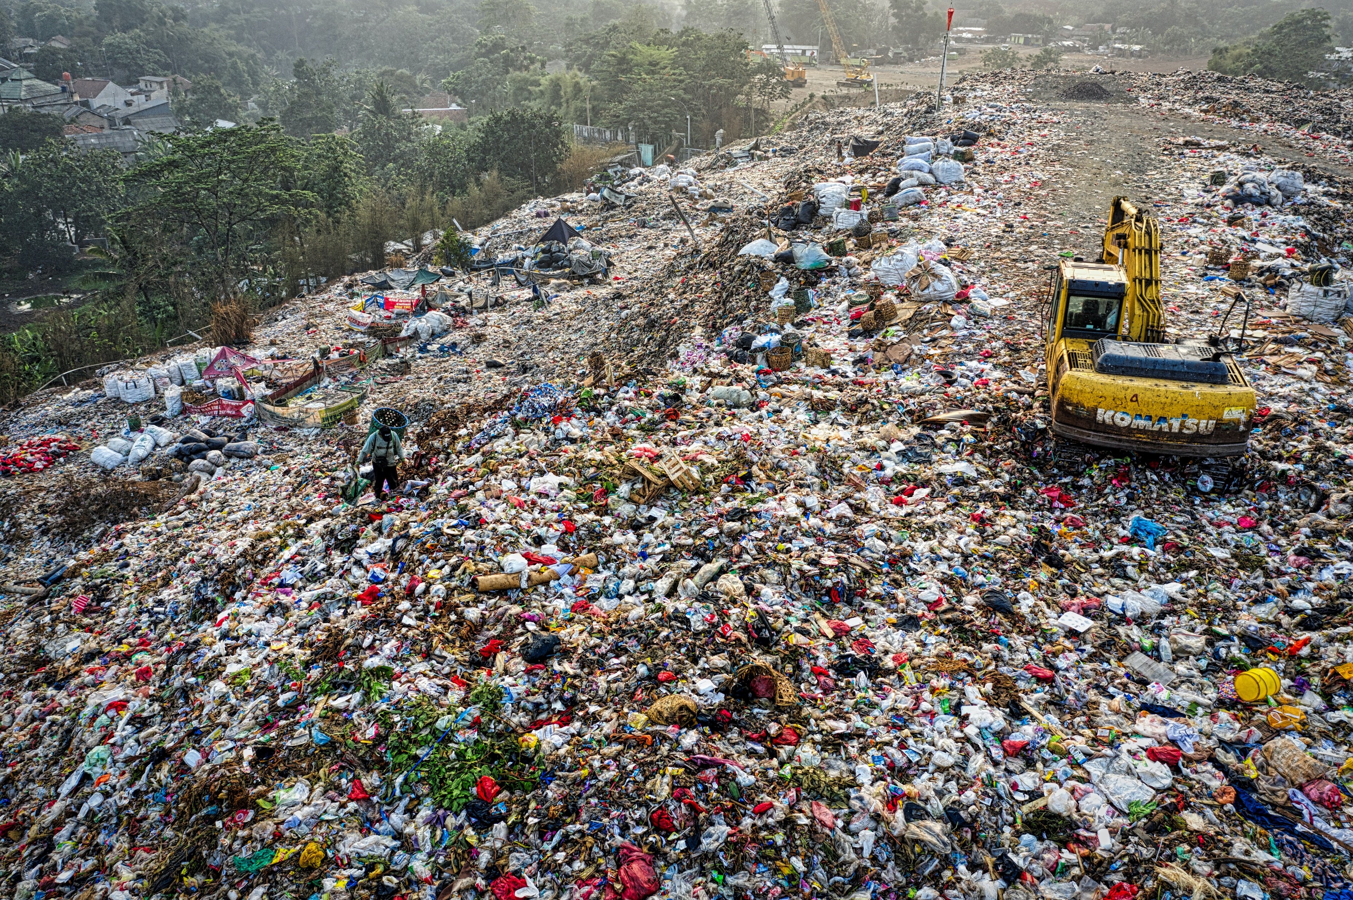
NielsenIQ: The Leading Edge
Barriers and Enablers
Consumer sentiment
Social movement
Governance
Weight of Investment
Scalability
Readiness
Competitive advantage
5.0
Reduced plastic
Renewable energy
4.7
Regenerative agriculture
4.0
3.9
Low Waste/Carbon Footprint
Source: NielsenIQ Leading Edge Report; Scores have been assigned from 1 to 5, where 1 = very unlikely and 5 = very likely
Notes:
61% agree environmental issues are having an adverse impact on their current and future health.

Slide 9
5.0
Reduced plastic
Ratings
 | Consumer sentiment
 | Social movement
 | Governance
 | Weight of Investment
 | Scalability
 | Readiness
 | Competitive advantage
5
5
5
5
+53%
Consumers want companies to reduce the amount of plastic in packaging
5
5
Sales growth vs 3YA
+157%
Plastic free
+18%
Sustainable packaging
5
Source: NielsenIQ Leading Edge Report; Scores have been assigned from 1 to 5, where 1 = very unlikely and 5 = very likely
NielsenIQ Omnibus Survey 2021, NielsenIQ Retail Measurement Services, NielsenIQ Product Insight; Total Store; Total US xAOC; Latest 52 weeks 08/06/22 vs 3YA
Notes:
The examples of initiatives all over the world in reduced plastic and recycling is incredibly compelling. As some of the most visible companies in the world distance themselves from this issue there will be no excuses for businesses that have not done the same. If companies have not done so by choice in the next few years, they are likely to be forced through legislation to divest.
61% agree environmental issues are having an adverse impact on their current and future health.

Slide 10
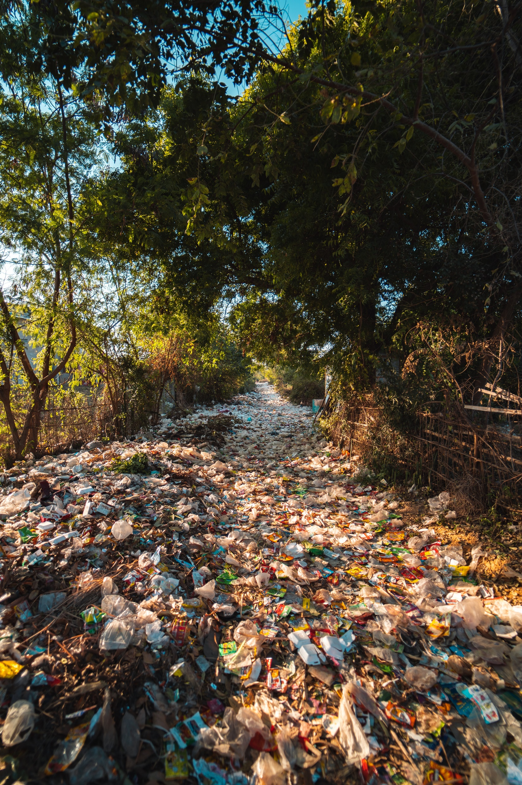
Consumers want companies to take action
Reduce the amount of plastic in packaging | 53%
Be efficient, eliminate material waste | 51%
Use sustainable packaging materials | 46%
Reduce production waste, reintroducing it into manufacturing cycle | 44%
Reduce the packaging of products | 44%
Reduce the amount of CO2 emitted | 37%
Reduce the amount of energy used in the production process | 33%
Reduce the amount of water used in the production cycle | 30%
Only use sustainable suppliers | 22%
Reduce transport required for raw materials/ end product distribution | 22%
Only use locally sourced materials/ingredients | 21%
Produce close to the markets where products are sold | 20%
Don’t know/Not sure | 19%
Only use local suppliers | 18%
Be active in charitable engagements | 16%
Other | 1%
To be called sustainable, which of the following actions should companies take?
NielsenIQ Omnibus Survey, Dec 2021, Q4. To be called sustainable, which of the following actions should companies take? Please select all that apply.

Slide 11
Sustainable packaging has opportunity across store
Recyclable is becoming baseline
 |  | $ % C3YA | $ Volume
 | Total Store | +22%
 | All Sustainable Packaging | +21% | $65.9B
Proven trends | Recyclable¹ | +27% | $291.1B
 | Recycled Packaging | +10% | $35.3B
 | Recycled Packaging Content | +10% | $25.6B
Growing trends | Free from BPA | +31% | $16.0B
 | 100% recycled paperboard | +10% | $15.2B
 | Terracycle | +37% | $7.8B
Developing trends | Tetra pak certified | +35% | $2.0B
 | Renewable Packaging Content | +99% | $321.7M
 | Plastic-Free | +142% | $219.6M
20
of the largest CPG manufacturers have committed to 100% recyclable packaging by 2030²
‘Stated‘ claims on package
Source: NielsenIQ Retail Measurement Services, NielsenIQ Product Insight, powered by Label Insight, Total Store; Total US xAOC; 52 weeks W/E 009/10/22 vs 3YA
1 - Recyclable is not included in the “All Sustainable Packaging” total attribute
2 - Consumer Brands Association, 20

Slide 12
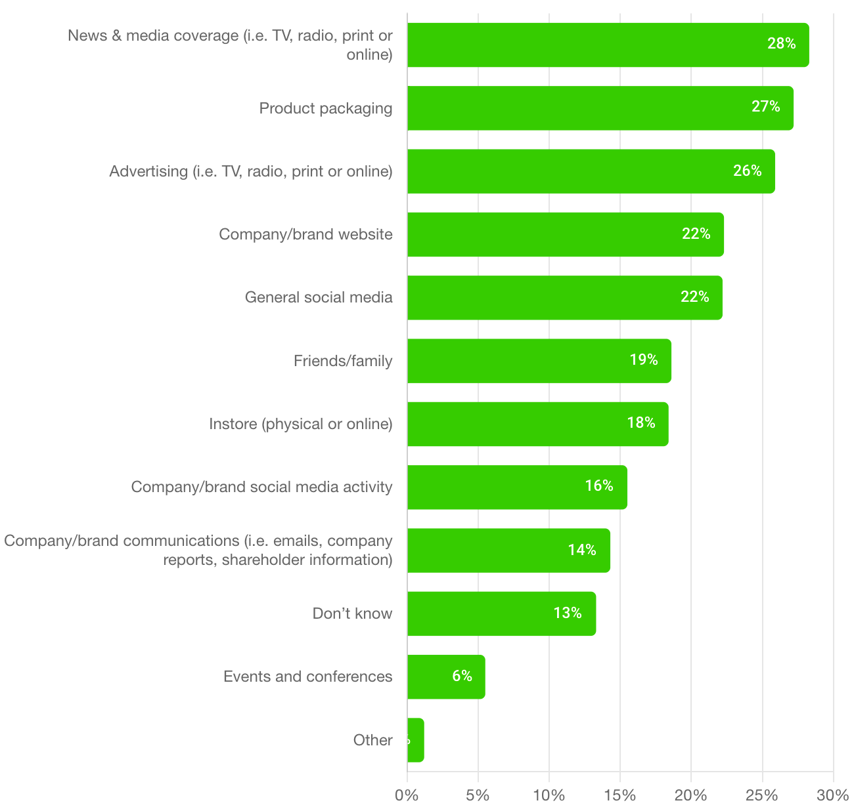
Consumers prefer to learn about a brand's ESG programs through news & media coverage and product packaging
Where would you prefer to learn about a company or brand’s environmental and social programs and behavior?
How well are you communicating your ESG strategy to consumers?
Product packaging claims give consumers the information they need at the shelf, at the time of purchase
Keep up with competition: Understand which claims and certifications are table stakes in your category and which claims and certifications will help your brand stand out vs competition
Source: Glow; Sample size n=11,507 US Adults, nat rep

Slide 13
Consumers want companies to take action
Reduce the amount of plastic in packaging | 53%
Be efficient, eliminate material waste | 51%
Use sustainable packaging materials | 46%
Reduce production waste, reintroducing it into manufacturing cycle | 44%
Reduce the packaging of products | 44%
Reduce the amount of CO2 emitted | 37%
Reduce the amount of energy used in the production process | 33%
Reduce the amount of water used in the production cycle | 30%
Only use sustainable suppliers | 22%
Reduce transport required for raw materials/ end product distribution | 22%
Only use locally sourced materials/ingredients | 21%
Produce close to the markets where products are sold | 20%
Don’t know/Not sure | 19%
Only use local suppliers | 18%
Be active in charitable engagements | 16%
Other | 1%
To be called sustainable, which of the following actions should companies take?
NielsenIQ Omnibus Survey, Dec 2021, Q4. To be called sustainable, which of the following actions should companies take? Please select all that apply.

Slide 14
Low
Waste/Carbon Footprint
3.9
Ratings
 | Consumer sentiment
 | Social movement
 | Governance
 | Weight of Investment
 | Scalability
 | Readiness
 | Competitive advantage
5
5
5
4
+37%
Want companies to reduce the amount of CO² emitted
3
2
Sales growth vs 3YA
+34%
Zero Waste
+12%
Reduced Carbon impact
3
Source: NielsenIQ Leading Edge Report; Scores have been assigned from 1 to 5, where 1 = very unlikely and 5 = very likely
NielsenIQ Omnibus Survey 2021, NielsenIQ Retail Measurement Services, NielsenIQ Product Insight; Total Store; Total US xAOC; Latest 52 weeks 08/06/22 vs 3YA
Notes:
The examples of initiatives all over the world in reduced plastic and recycling is incredibly compelling. As some of the most visible companies in the world distance themselves from this issue there will be no excuses for businesses that have not done the same. If companies have not done so by choice in the next few years, they are likely to be forced through legislation to divest.
61% agree environmental issues are having an adverse impact on their current and future health.

Slide 15
Animal welfare key across all categories in the store
Hidden Slide
+37.1%
Animal Welfare Growth
Personal Care |  | Household Care |  | Grocery
1 | Animal welfare certified | 1 | Manufactured in a sustainable way | 1 | Grown or raised in a sustainable way
2 | Cruelty free | 2 | Cruelty free | 2 | Certified humane raised and handled
3 | Manufactured in a sustainable way | 3 | Plant based | 3 | Free range
4 | Sourced from partners offering fair wages | 4 | Free of animal by-products | 4 | Sourced from partners offering fair wage
5 | Free of animal by-products | 5 | Forest Stewardship Council (FSC) certified | 5 | Hormone free
+69.0% Cruelty Free
+43.7% Grass Fed +39.6% Cage Free +39.5% Humane +37.1% Free Range
Based on relative appeal of claims gathered during optimization among global consumers
BASES Optimizer Study on Sustainability Claims and Consumer Motivations (2021); data based on relative appeal of claims gathered during optimization within the United States, United Kingdom, Germany, Brazil and China
Source: NielsenIQ Retail Measurement Services, NielsenIQ Product Insight, powered by Label Insight, Total Store; Total US xAOC; Latest 52 weeks W/E 08/06/22 vs 3YA
Notes:
@Sherry Frey we can use the same citation here:
BASES Optimizer Study on Sustainability Claims and Consumer Motivations (2021); data based on relative appeal of claims gathered during optimization within the United States, United Kingdom, Germany, Brazil and China

Slide 16
The youngest consumers are powerful force for sustainability in the future
# of Environmentally-conscience Low Income 18-34-year-olds is Greater Than All Other Age Groups – Currently Income-Limited Demographic On the Rise with Power to Shift Market In Upcoming Years
All Environmental Attribute Purchases by Low Usage Households
Total $ per 100 HHs Index
% HH Penetration
55% | 41% | 32% | 28% | 29% | 30% | 39%
Source: NielsenIQ Spectra Homescan Panel; Consumer Profile by Demographics; Total US; $ per 100 HHs Index –May 2022 YTD Sales and 2021 Census

Slide 17
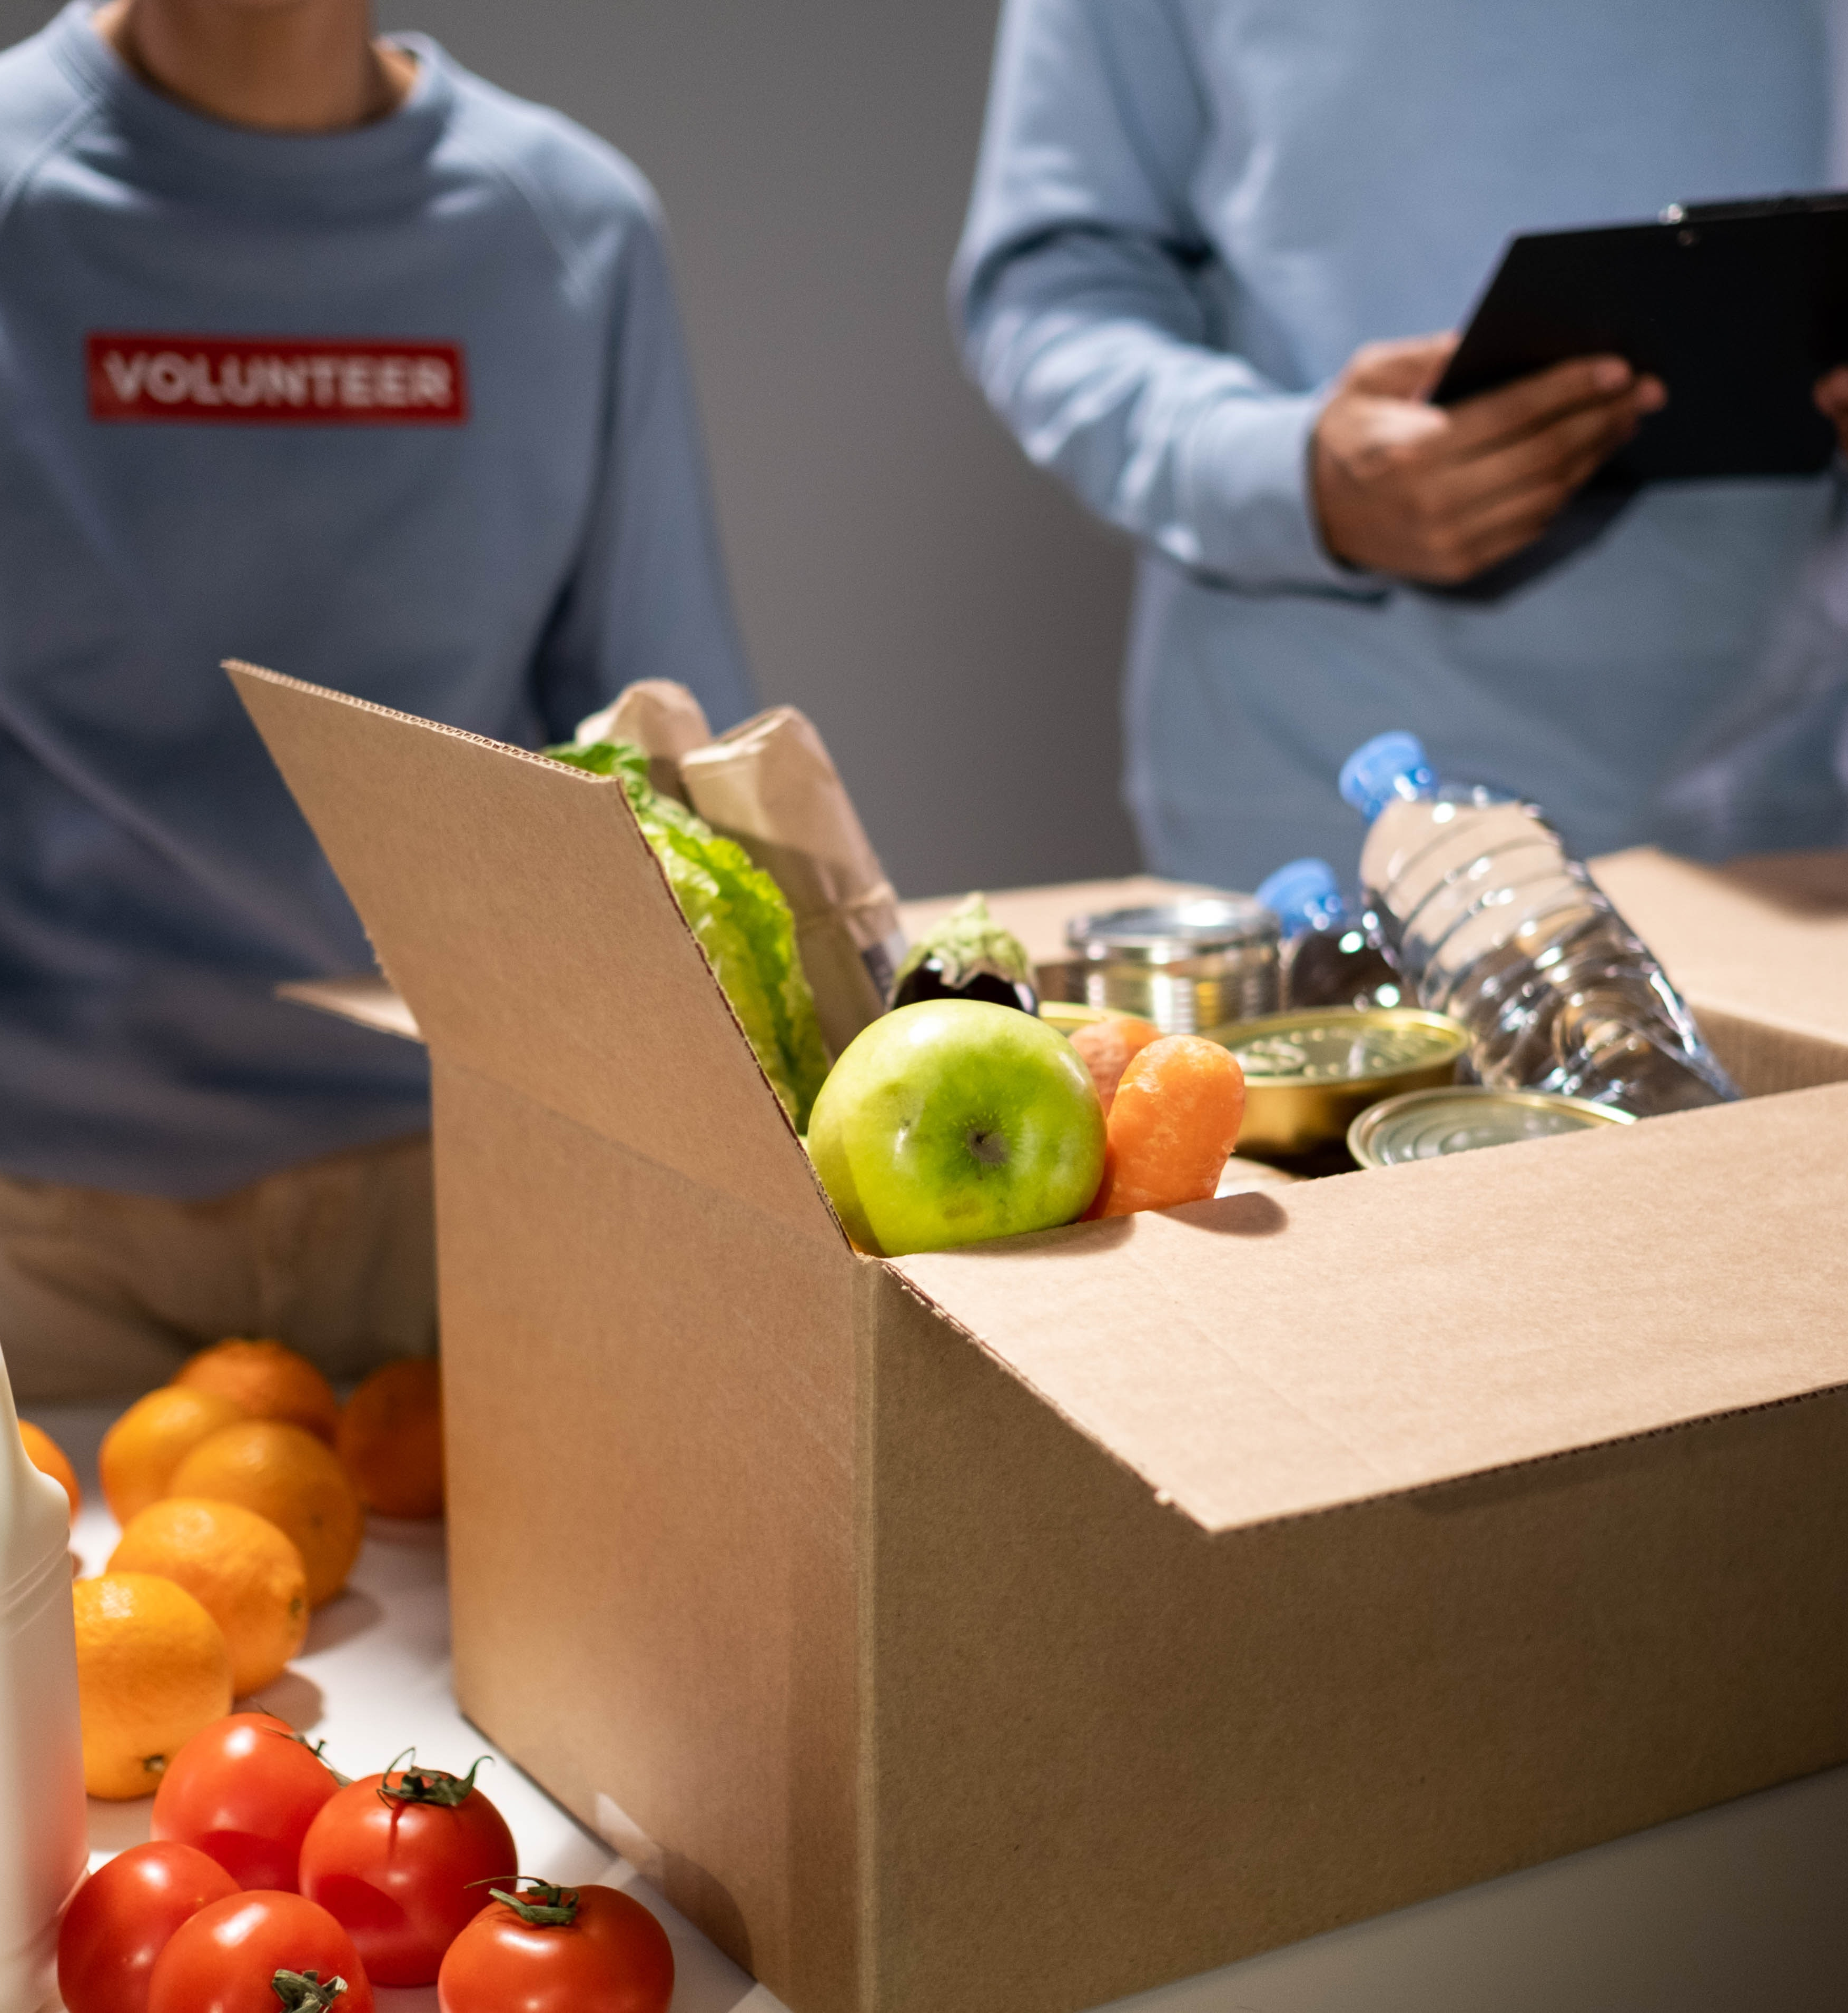
Social responsibility = wellness for all
69%
Want retailer regulation for fresh and healthy food availability/affordability for all
64%
Will pay more for products supporting communities and vulnerable groups
+22%
Sales growth for socially-responsible products
NielsenIQ Health and Wellness Study, NielsenIQ Retail Measurement Services, NielsenIQ Product Insight,; Total US xAOC; 52 weeks W/E 08/06/22 vs 3YA

Slide 18
Brands showing social responsibility seeing growth
Natural Channel show strongest index of socially responsible sales
$ % Change vs. 3 years ago
*Sorted by sales volume—descending
$ Share Index of All Social Responsibility vs Total Store
Source: NielsenIQ Retail Measurement Services, NielsenIQ Product Insight, powered by Label Insight, Total Store; Total US xAOC; 52 weeks W/E 08/06/22 vs 3YA
NielsenIQ Homescan Panel; Total US across all Channels; 52 weeks W/E 09/10/22
Notes:
Prem Fresh Grocery’s share of all Social Responsibility sales is 2.5x higher than its fair share
Future: let’s also look at the # of items selling
Social responsibility qualified $19.9 Billion
Responsibility Sourced Stated $7.9B
B Corp Stated $6.2B
Fair Trade Stated $3.3B
Ethical Stated $2.7B
Women Owned $753.4M
Fair Wages Stated $119.4M
Others of note:
Veteran Owned $39.9M (+614%)
Minority Owned ($9.7M (+331%)
Black Owned ($6.1M (+3,399%)

Slide 19
Diversity, equity and inclusion key to growth
+13 pts
Faster growth for independent CPG companies with stronger consumer diversity¹
Source: NielsenIQ, U.S. Census, 2020, NielsenIQ 52 WE 8/27/22, Total Outlets
1 - NielsenIQ Retail Measurement Services, NielsenIQ Product Insight, powered by Label Insight, Total Store; Total US xAOC; 52 weeks W/E 08/27/22 vs 2YA

Slide 20
Consumers most willing to pay premium for sustainable, socially responsible and supply transparency
Hidden Slide
% of respondents willing to pay more for products with the following attributes / features
Source: NielsenIQ Global Health & Wellness Study of 17 markets, September 2021

Slide 21
Sustainability and Social Responsibility Growing
PLASTIC FREE (+157%)
Legend
REGENERATIVE AGRICULTURE (+127%)
FOOD AS MEDICINE
NATURAL/ORGANIC
CLEAN LABEL
PLANT BASED
SUSTAINABILITY/SOCIAL RESPONSIBILITY
“Growth Drivers” – U.S. Sales vs. 3YA
“Total Store Expansion”- Count of U.S. categories (>2,100 total categories in Total Store*)
Bubble size denotes total sales in L52 week All attributes represent claims STATED on package unless indicated by an * symbol
Source: NielsenIQ Retail Measurement Services, NielsenIQ Product Insight, powered by Label Insight, Total Store; Total US xAOC; 52 weeks W/E 08/06/22 vs 3YA

Slide 22
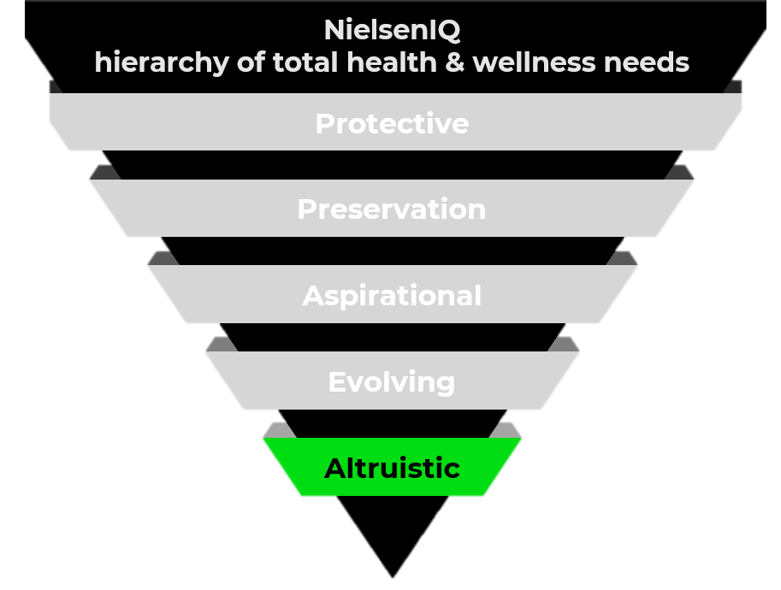
Looking to the future of wellness
Micro-culture Maturity Curve Health & Wellness in the context of “Altruism”
Microculture | Key Topics | Maturity
Aging with dignity | Senior care, small acts of service, community care | 50.6%
Mental health advocacy | Mental wellbeing, de-stigmatizing, stressors | 44.4%
Social bonds | Social health, interaction for health benefits | 41.2%
Healthy eating for all | Nutritional diet, better eating for health of community | 37.0%
Sustainable wellness | Sustainable lifestyle, support environment and own sense of wellness | 33.9%
53.5%
43.3%
predicted
current
New
ideas
Early
consensus
Mainstream
acceptance
Established
ideas
Source: MotivBase, a NielsenIQ Connected Partner
Notes:
LI LIVE --- To dive deeper on this notion of health and wellness within the context of altruism, NielsenIQ turned to MotivBase, a valued member of the NielsenIQ Partner Network. Through extensively examining hundreds of thousands of anonymized consumer conversations across the US market, MotivBase identified five microcultures to watch.
The maturation of a topic has meaningful impact on possible innovation paths to pursue.
Aging with dignity- Consumers strive to help their aging family and neighbors thrive in their golden years with dignity, independence, and good health
Mental health advocacy -Consumers want to end the stigma around mental health, turning their focus to workplace culture and health programs in particular
Social bonds -Consumers proactively nurture existing social bonds while also creating new ones to boost the health of themselves and others
Healthy eating for all-Consumers believe nutrition education and access are critical barriers to community health
Sustainable wellness -Consumers directly connect living a sustainable lifestyle with the mental and physical health of society and that of themselves.
THE ZONE OF INNOVATION FOR ALTRUISM According to MotivBase benchmark studies, the key​ time to launch a solution into​ market is when a demand space​ falls between 33% - 55% on the​ maturity curve.
Within the U.S., MotivBase concludes that there is a longer runway for altruistic innovation tied to the microculture of eating for optimal health, which has an estimated 37% maturity and expectations of 13% predicted growth among the number of people this topic will be relevant to. Now is an opportune time to innovate and build on current motivations and values, which are centered around social health, obesity, and the disparity in access to healthy and nutritious food in America.
Worth noting, there is high levels of volatility among multiple altruistic microcultures in the U.S. In these volatile instances, consensus and meaning around a topic is pivoting on a dime and regular evaluation and continuous innovation will be necessary for continued relevance, and eventual success, among consumers. In these instances, current messaging and plans around a topic, such as mental health advocacy, should be re-evaluated.

Slide 23
Meet today's speakers
Sherry Frey
VP, Total Wellness
NielsenIQ
Spike Mendelsohn
Co-Founder and Executive Chef
Eat the Change/PLNT Burger
Julia Collins
Founder
Moonshot Snacks and Planet FWD
Sophie Rifkin
Senior Director of Sustainability
Banza
Steven Jamieson
Health and Body Care Merchandiser
PCC Community Markets

Slide 24
Download today’s presentation. Visit us at booth 1929

