Slide 1

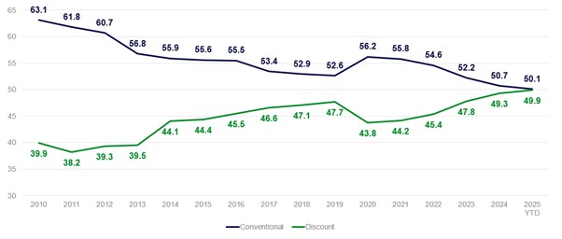
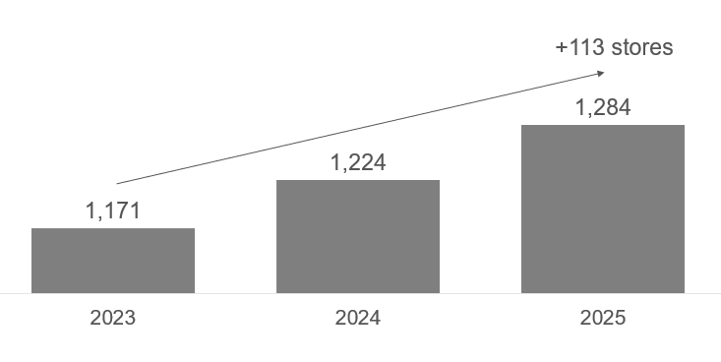

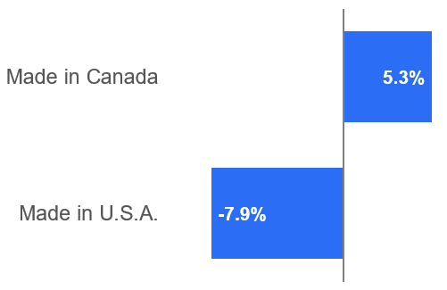


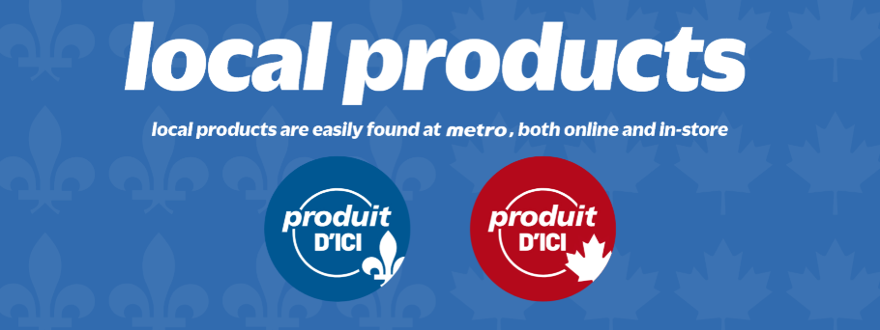
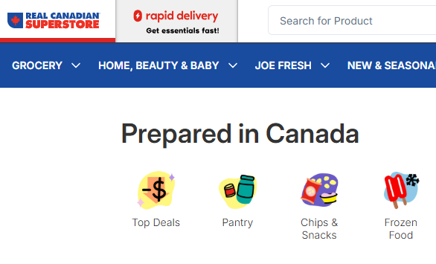


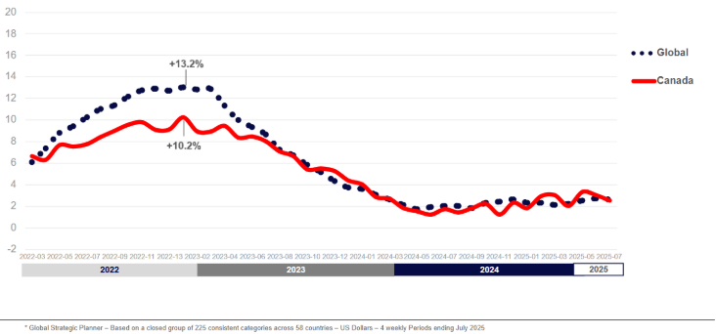
Inflation & Shopper Behaviour
The Discount channels share of the Grocery + Drug + Mass channel increased +10 points from 2010 compared to the conventional channel.
Inflation &
Shopping Behaviour
October 14, 2025
With FMCG inflation on roller coaster between 2.1% and 3.1% since Dec '24 – Aug '25 Canadian Shoppers continue to search for value with Discount now attracting growth from the highest income households.
Tariffs are impacting shopper perception and behaviour and they're voting with their wallets for Made in Canada.
Retailers are investing to support shopper trends and make the in-store search easier for local.
Canadian Retailers have appealed to the consumer's need for value by opening over 100 more discount stores over the past 2 years.
Retailers and independent phone apps make it easier for Canadians consumers to find Canadian products. Canadian products outpace U.S. products +5.3% vs. –7.9% respectively year to date Sept 2025.
Mike Ljubicic
Managing Director,
Canada, NielsenIQ
"Shop Canadian" app
Increased commodity prices on things like Cocoa, Coffee, Eggs, Canola, Tree Nuts, Pork, Cattle, Poultry, Corn, Oats, Finfish, Shellfish are being felt globally on FMCG pricing. As well as aluminum and steel metals used for packaging.
Roughly 50% of FMCG volume is being sold on promotion and uncertainties & unknowns will continue to keep shoppers frugal!
FMCG Inflation is a Global Phenomenon and not a stand-alone Canadian challenge

